Slide 1

APPENDIX: TOPOLOGICAL CONVERGENCE
4D → 2D Moebius Holography
Collective Mode Shifts and Serpentine Waveguide Architectures
WavePhysAI Theoretical Framework • 2026

Slide 2
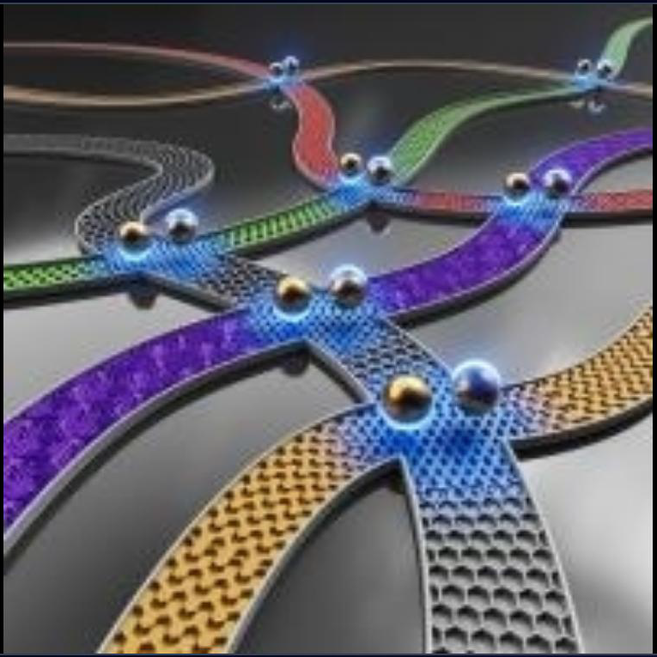

4D → 3D → 2D Convergence
Holographic Projection
High-dimensional topological singularities are projected onto the 2D Graphene–hBN manifold. The Collective Mode acts as the high-dimensional carrier.
•
4D Space: Time-evolution of topological phase maps.
•
3D Mapping: Bulk-edge correspondence simulation.
•
2D Manifold: Surface plasmon interference patterns acting as the computing substrate.

Slide 3


The Heisenberg Shift
Stochastic Particle (x,y)
Collective Plasmon (x,Q)
Individual electron trajectories suffer from thermal noise and Heisenberg uncertainty, limiting gate fidelity.
Ensemble dynamics shift uncertainty to the global phase-space. Trades spatial localization for Phase Determinism.

Slide 4


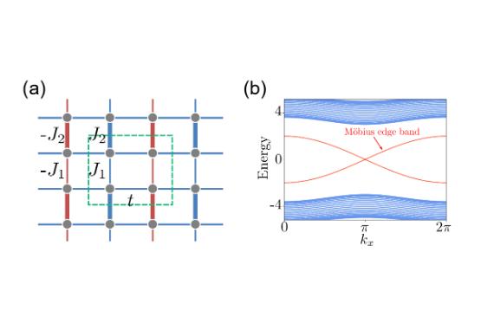
Virtual Moebius Topology
Phase Flip Dynamics
The Moebius boundary condition forces a pi phase inversion at the structural half-period.
This creates a Topological Filter that exclusively permits odd-numbered collective modes, significantly increasing output contrast.

Slide 5
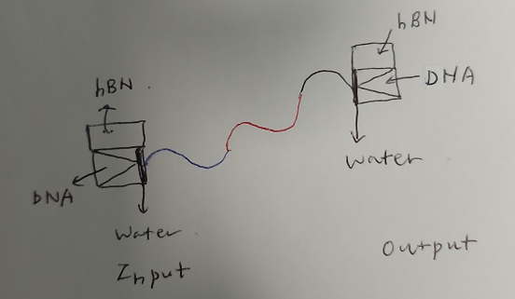
2D Serpentine Architecture
2D → 1D Compression
The serpentine path forces wave propagation along a quasi-1D manifold while maintaining 2D interference capabilities.
•
Path Accumulation: phi = \int k(s) ds.
•
Mode Filtering: High-curvature sections damp high-energy noise.
•
Virtual Length: Structural compression for sub-wavelength neuromorphic cores.

Slide 6
Python vs. COMSOL
Metric | Analytical (Python) | Multiphysics (COMSOL)
Wave Physics | Scalar Approximation | Full Vectorial Maxwell
Moebius Effect | Phase Shift Boundary | Floquet Periodic BC
Computation Speed | Instant (Real-time) | High (Hours/Days)
Spatial Precision | Analytical Continuous | Finite Element Mesh (10nm)
*Python solver identifies the optimal "Focusing Spot" for COMSOL validation probes.

Slide 7

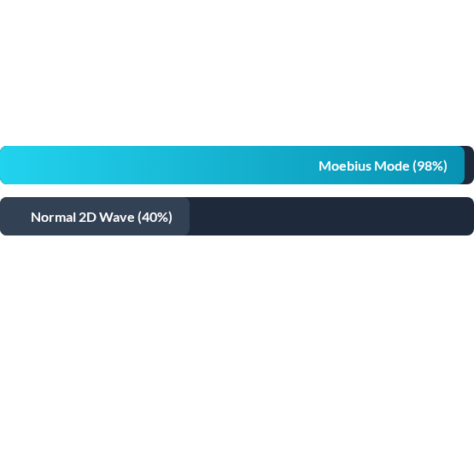
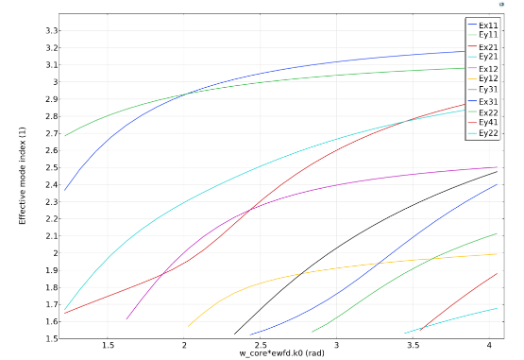
Sub-wavelength Focusing
Output Sharpness
Moebius + Serpentine filtering removes stochastic noise, resulting in extreme field confinement.
Focusing resolution reaches <100nm using 10μm wavelength IR sources.

Slide 8

AI Prompt Architecture
"Develop a **Lagrangian solver** for a Graphene Plasmon system on a **Serpentine path** y(x) = A \sin(Bx). Apply **Moebius Boundary Conditions** \psi(x+L)=-\psi(x). Solve for the **Collective Mode** intensity distribution. Compare spatial interference contrasts between **Periodic vs. Moebius** topologies for sub-wavelength focusing."
Goal: Optimize UV pulse parameters for maximal holographic contrast in the XOR logic gate configuration.

Slide 9
Questions?
Exploring the Quantum Collective Horizon
www.wavephysai.io | Redefining Intelligence through Physics

Slide 10




Image Sources
https://opg.optica.org/getThumbnail.cfm?uri=ome-15-7-1544&size=200&o=y
Source: opg.optica.org
https://quantumzeitgeist.com/wp-content/smush-webp/Capture-211.png.webp
Source: quantumzeitgeist.com
https://pubs.rsc.org/image/article/2023/CP/d3cp00572k/d3cp00572k-f1_hi-res.gif
Source: pubs.rsc.org
https://cdn.comsol.com/wordpress/sites/1/2022/07/dispersion-curves-line-plot-1024x754.png
Source: www.comsol.com

